Slide 1
Online Banking System Simulation
Jakka Bhanu — 2520030006
Anand Akshita — 2520030043

Slide 2
OVERVIEW
Project Abstract
This project simulates a robust online banking backend, developed with a core focus on addressing critical vulnerabilities found in traditional systems while ensuring secure, scalable, and maintainable operations.
Secure Transaction Processing
Scalable System Architecture
Modular & Maintainable Codebase
Implementing advanced mechanisms to protect financial data and ensure integrity across all operations.
Designed to handle high user loads and complex banking demands efficiently as the system grows.
A clearly structured application that simplifies future development, testing, and long-term support.
Notes:
This slide introduces the project's purpose and key areas of focus. I'll briefly explain that we're simulating a banking backend to highlight best practices in system design.
I'll emphasize the three main pillars: secure transactions, a scalable architecture, and a maintainable codebase. These are the core problems this project aims to solve and demonstrate a solution for.

Slide 3

PROJECT SCOPE
What This Project Delivers
A banking backend that handles everyday operations, keeps the code organized, protects transactions, and supports many users at once.
Banking Operations
Clean Structure
Users can manage accounts, make deposits and withdrawals, send money, and view transaction history.
The app is split into clear layers, so each part has one job and is easier to build and maintain.
Safe Transactions
Built for Scale
Money updates are handled carefully so balances stay correct, even when multiple actions happen at the same time.
The system is designed to keep working smoothly as more users and requests are added.

Slide 4



PROBLEM STATEMENT
The Problem: Why Banking Backends Fail
Banking systems need to keep information correct, handle many people at once, and stay fast. Simple systems often struggle with these three things and break when the pressure grows.
Data Gets Messed Up
Multiple Users Cause Crashes
When the same customer or account information is stored in too many places, it is easy for records to get out of sync. For example, one screen may show the wrong balance after an update.
When several people use the system at the same time, one action can interfere with another. For example, two transfers from the same account can create errors or wrong totals.
The System Gets Slow
As more customers and transactions are added, simple searches and reports take longer. For example, a balance lookup that used to be quick can become frustratingly slow.

Slide 5







COMPARATIVE ANALYSIS
Existing vs. Proposed Approach
A simple side-by-side comparison of the current approach and the improved system.
Code Organization
Bad: Mixed together
Good: Clear responsibilities
Old way
Mixed code, weak data protection, slow performance, difficult maintenance, and fragile reliability.
Data Safety
Bad: Easy to change by mistake
Good: Protected and consistent
New way
Performance
Clear structure, safer data, better speed, easier maintenance, and stronger reliability.
Bad: Slows down as it grows
Good: Stays fast
Maintainability
Bad: Hard to update and fix
Good: Easy to change and extend
Reliability
Bad: Breaks under pressure
Good: Works consistently

Slide 6
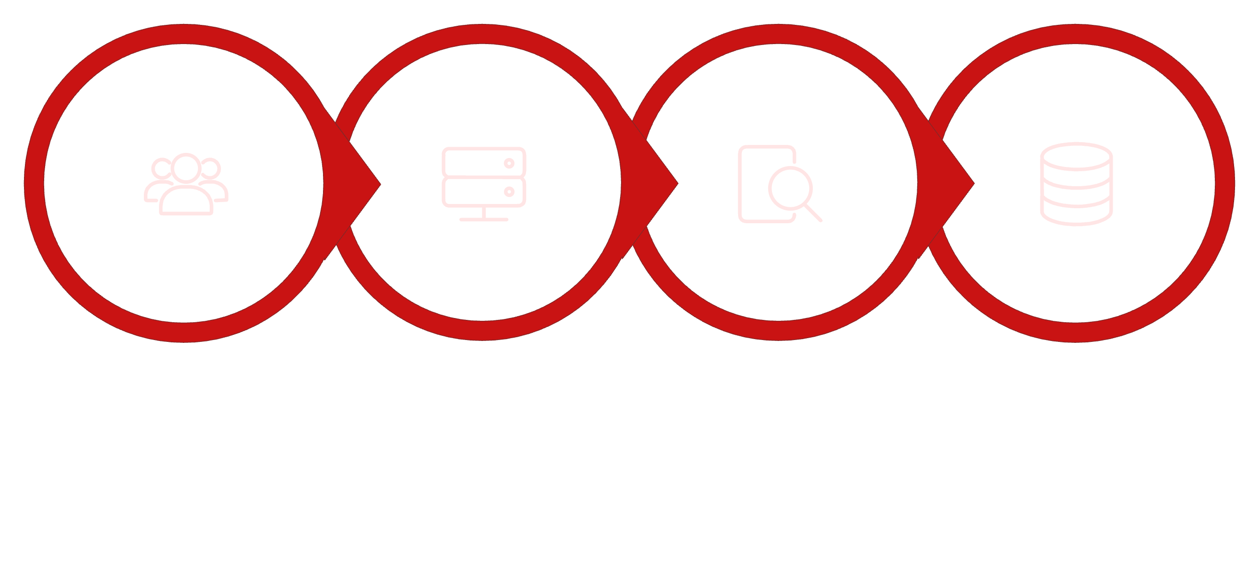
ARCHITECTURE
System Architecture: Request to Save
How a request moves through the system in four simple steps
User sends
Server receives
Server checks
Data saved
Layered request flow
Request Layer: HTTP arrives at the Express.js API, where the request is accepted and routed into the application.
Validation & Business Logic: The service checks data integrity, enforces banking rules, and applies domain-specific safeguards before any write occurs.
Data Access Layer: The query builder constructs parameterized SQL and isolates persistence concerns from business logic.
Persistence: PostgreSQL primary node executes the transaction with ACID guarantees, ensuring the save is durable and consistent.
Data layer note: the primary node handles writes with full ACID protection; replica nodes serve read-heavy queries; sharding by customer ID enables horizontal scaling.
This flow shows the full path a request takes through the stack, from the API edge through validation and data access to durable database storage.

Slide 7




TECHNOLOGY STACK
Technology Stack
Four core categories used to build, manage, and organize the backend project.
Frontend
Backend
HTML and JavaScript work together to structure the interface and power the application logic.
Node.js and Express.js run the server and handle routes, requests, and responses.
Database
Version Control
SQL is used to work with data, including creating, reading, updating, and deleting records.
Git and GitHub track changes, store the project online, and make collaboration easier.

Slide 8
Thank You

